Slide 1
Operating Systems
C Refresher
Professor Yotov

Slide 2
Learn C in 120 minutes
Just kidding, it takes longer than that!
But we’ll cover the basics in class today
For more details, you can consult:
Brian Kernighan and Dennis Ritchie, The C Programming Language https://archive.org/details/TheCProgrammingLanguage
Zed Shaw, Learn C the Hard Way http://c.learncodethehardway.org/book/
For the very brave: The C Language Specification http://www.open-std.org/jtc1/sc22/wg14/

Slide 3
A First Program
#include <stdio.h>
int main() {
printf("Hello, world\n");
return 0;
}

Slide 4
A First Program
Include file: similar to “import” in Python
#include <stdio.h>
int main() {
printf("Hello, world\n");
return 0;
}

Slide 5
A First Program
Declaration of function “main”, returning type “int”
#include <stdio.h>
int main() {
printf("Hello, world\n");
return 0;
}

Slide 6
A First Program
Calling the printf function with a string parameter
#include <stdio.h>
int main() {
printf("Hello, world\n");
return 0;
}

Slide 7
A First Program
Each statement must end with a semicolon
#include <stdio.h>
int main() {
printf("Hello, world\n");
return 0;
}

Slide 8
A First Program
#include <stdio.h>
int main() {
printf("Hello, world\n");
return 0;
}
Return the value 0

Slide 9
Compiling and Running
$ gcc hello.c -o hello
$ ./hello
Hello, world
$

Slide 10
Side Note: Your Environment
Where exactly do you run gcc?
At the command line
On OS X, this is in the Terminal App (/Applications/Utilities)
In Linux, xterm, gnome-terminal, etc. are all fine
On Windows – use the virtual machine I posted
If you are not already comfortable using the command line, there are many excellent short tutorials that can help you

Slide 11
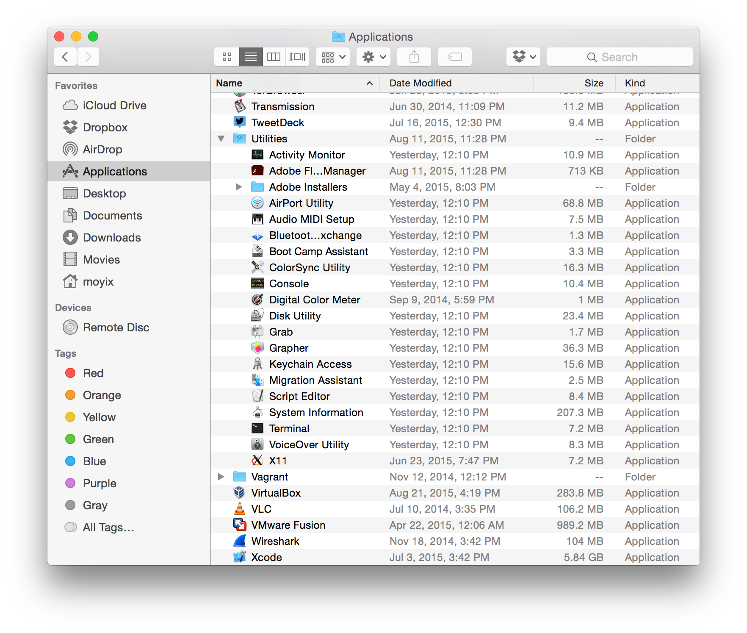

Slide 12
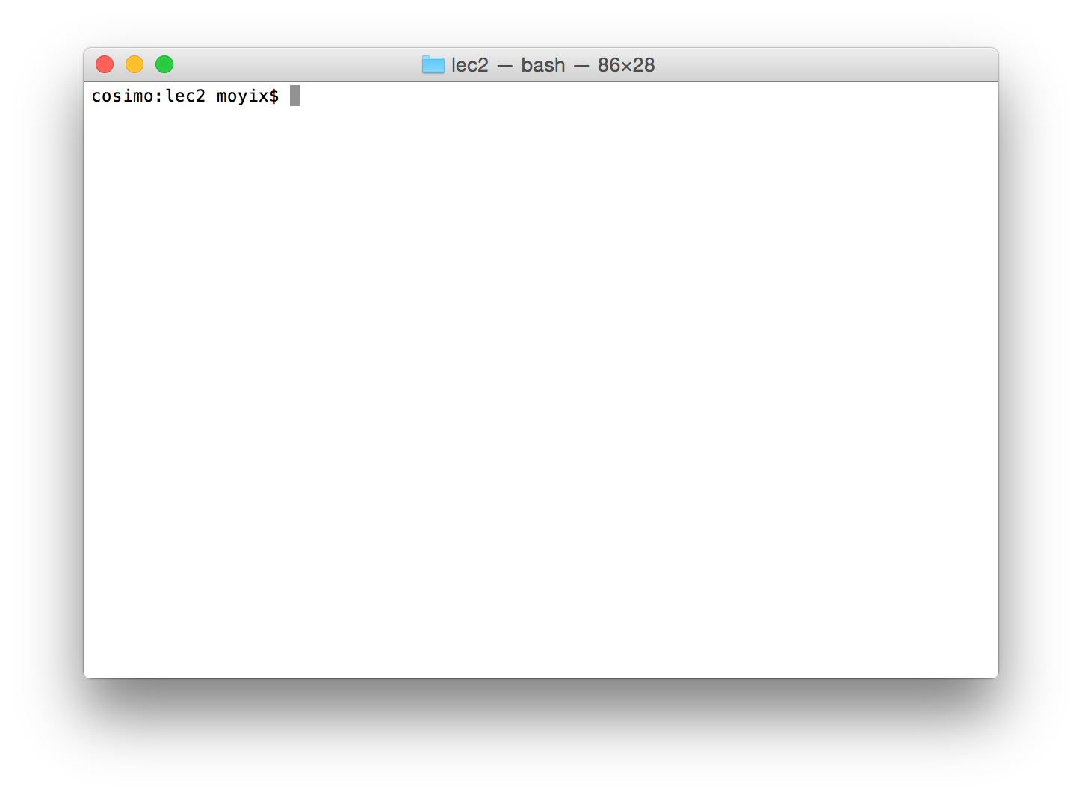
OS X Terminal

Slide 13
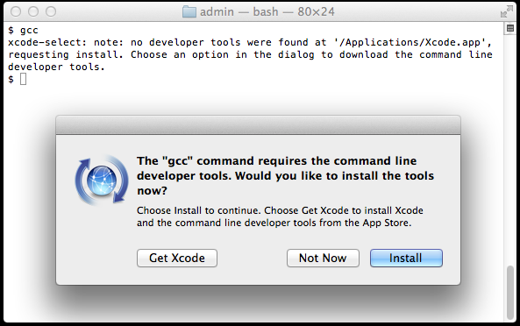
Installing a Compiler

Slide 14
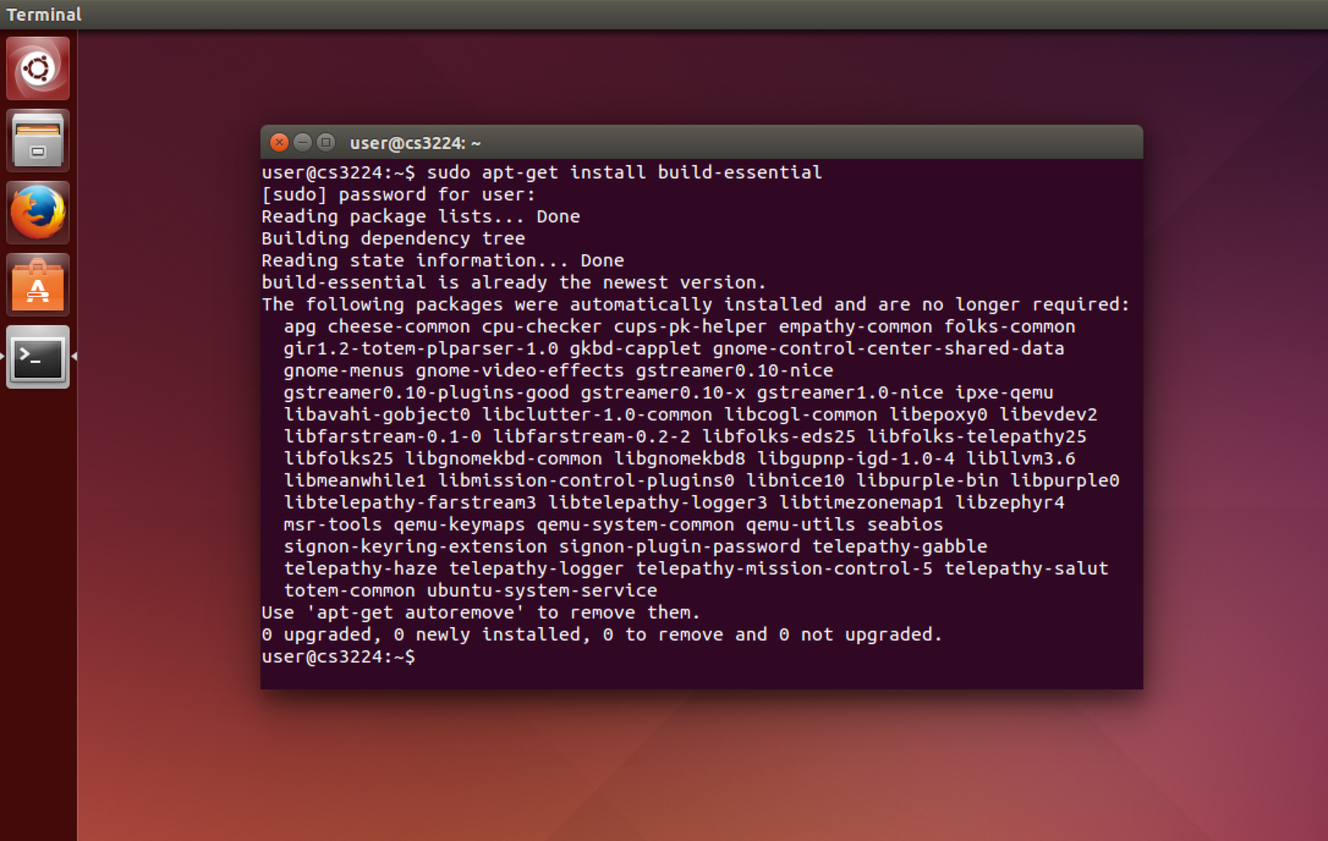
Linux Terminal

Slide 15
The Compilation Process
Invoking gcc on hello.c did the following things:
Called the C preprocessor (cpp) on hello.c
cpp looked for stdio.h in the default include path (a set of directories where header files live) and then recursively called itself on stdio.h
The output of that process was pasted into hello.c, and the result was compiled by gcc into an executable binary

Slide 16
Viewing Preprocessor Output
If you want to see what the preprocessed file looks like, you can do gcc -E hello.c -o hello.pp
Then you can look at hello.pp

Slide 17
# 1 "hello.c"
# 1 "<built-in>" 1
# 1 "<built-in>" 3
# 321 "<built-in>" 3
# 1 "<command line>" 1
# 1 "<built-in>" 2
# 1 "hello.c" 2
# 1 "/usr/include/stdio.h" 1 3 4
[…]
char *gets(char *);
void perror(const char *);
int printf(const char * restrict, ...) __attribute__((__format__ (__printf__, 1, 2)));
int putc(int, FILE *);
int putchar(int);
[…]
# 493 "/usr/include/stdio.h" 2 3 4
# 2 "hello.c" 2
int main() {
printf("Hello, world\n");
return 0;
}

Slide 18
Aside: Makefiles
Remembering and reproducing the commands to compile a project is tedious
Larger projects may have multiple files, many compilation options, external libraries, etc.
To manage this complexity we can use a Makefile

Slide 19
make
Instead of calling gcc, we can instead just do: $ make hello cc hello.c -o hello
The make command has some built-in rules that understand how to compile basic C and C++ programs
The make command will check whether the file "hello" exists and is newer than the file "hello.c"; if not, it will try to build "hello" using "hello.c"

Slide 20
A Makefile
For more complex rules, or to build things that make doesn't natively understand how to create, we use a Makefile: CFLAGS=-Wall -g clean: rm -f hello
Now we can have make clean up for us: $ make clean rm -f hello
Extra compile flags. Will be treated as if passed as args to gcc

Slide 21
A Makefile
For more complex rules, or to build things that make doesn't natively understand how to create, we use a Makefile: CFLAGS=-Wall -g clean: rm -f hello
Now we can have make clean up for us: $ make clean rm -f hello
The name of our new build target

Slide 22
A Makefile
For more complex rules, or to build things that make doesn't natively understand how to create, we use a Makefile: CFLAGS=-Wall -g clean: rm -f hello
Now we can have make clean up for us: $ make clean rm -f hello
The command to run to build the target

Slide 23
A Makefile
For more complex rules, or to build things that make doesn't natively understand how to create, we use a Makefile: CFLAGS=-Wall -g clean: rm -f hello
Now we can have make clean up for us: $ make clean rm -f hello
The command to run to build the target
NOTE: this must be a tab character, not spaces!

Slide 24
Back to C: Declaring Variables
#include <stdio.h>
int main() {
int height = 70;
int age;
age = 31;
printf("I'm %d years old and %d inches tall\n",
age, height);
return 0;
}

Slide 25
Back to C: Declaring Variables
Variable type
#include <stdio.h>
int main() {
int height = 70;
int age;
age = 31;
printf("I'm %d years old and %d inches tall\n",
age, height);
return 0;
}
Variable name
Initial value

Slide 26
C Built-in Types
Type | Min | Max
char | -128 | 127
unsigned char | 0 | 255
short | -32768 | 32767
unsigned short | 0 | 65535
int | -2147483648 | 2147483647
unsigned int | 0 | 4294967295
long | -9223372036854775808 | 9223372036854775807
unsigned long | 0 | 18446744073709551615
long long | -9223372036854775808 | 9223372036854775807
unsigned long long | 0 | 18446744073709551615
float | 32 bit IEEE floating-point
double | 64 bit IEEE floating-point
long double | 80 bit IEEE floating-point
Note: some of these ranges are different on different platforms and implementations of C. Here I'm giving the ranges for 32-bit x86, which is what we'll be working with this semester. More precise details can be found by consulting the C language specification.

Slide 27
C Operators
Arithmetic:
+ (plus), - (minus), / (division), * (multiplication), % (modulus)
Logical
&& (and), || (or), ! (not)
Relational
< (less than), > (greater than), >= (greater or equal), <= (less or equal), == (equal), != (not equal)

Slide 28
C Operators
Binary arithmetic
~x: one's complement (i.e., flip all bits)
x << n: shift x left by n bits
x >> n: shift y right by n bits
x & y: bitwise AND of x and y
x | y: bitwise OR of x and y
x ^ y: bitwise XOR of x and y

Slide 29
Control Flow
Branching:
if (condition) { statements } else if (condition) { statements } else { statements }

Slide 30
Control Flow
Branching:
switch (expression) { case 1: statements break; case 2: statements break; default: statements break; }

Slide 31
Control Flow
Looping while (condition) { statements } do { statements } while (condition);

Slide 32
Control Flow
Looping for (init ; condition ; update) { statements } Example: int i; for (i = 0; i < 100; i = i + 1) { printf("This is iteration %d\n", i); }

Slide 33
Putting It Together
"Write a program that prints the numbers from 1 to 100. But for multiples of three print “Fizz” instead of the number and for the multiples of five print “Buzz”. For numbers which are multiples of both three and five print “FizzBuzz”."

Slide 34
Putting It Together
#include <stdio.h>
int main() {
int i;
for (i = 1; i <= 100; i = i + 1) {
if (i % 3 == 0) {
printf("Fizz");
}
if (i % 5 == 0) {
printf("Buzz");
}
if ((i % 5) != 0 && (i % 3) != 0) {
printf("%d", i);
}
printf("\n");
}
return 0;
}

Slide 35
Functions
All code in C lives in a function
Declaring a function is simple: int add(double x, double y) { return x + y; }
Calling it is simple too int result = add(4.9, 12.1);

Slide 36
Functions
Return type
Function name
All code in C lives in a function
Declaring a function is simple: int add(double x, double y) { return x + y; }
Calling it is simple too int result = add(4.9, 12.1);
Parameters

Slide 37
Assignment Operators
x = y: simple assignment Note: x = y is an expression, and evaluates to the right hand side. So, you can do things like if ((x = y) > 0) ... which will assign x the value of y and branch if y is greater than 0
x += y: same as x = x + y
-=, *=, /=, <<=, >>=, %=, &=, |=

Slide 38
More C Operators
(Pre/Post) Increment/decrement
x++: evaluate x, then increment it
++x: increment x, then evaluate it
x--: evaluate x, then decrement it
--x: decrement, then evaluate it

Slide 39
Increment example
#include <stdio.h>
int main() {
int x = 0;
if (x++ > 0) {
printf("This will not be printed\n");
}
if (x > 0) {
printf("This will be printed\n");
}
x = 0;
if (++x > 0) {
printf("This will be printed\n");
}
if (x > 0) {
printf("And so will this\n");
}
return 0;
}

Slide 40
Arrays
Arrays in C are fixed-length (their size must be specified at compile time)
To declare an array: int x[10];
Then individual elements are accessible as x[i] where i is an integer

Slide 41
Array Bounds
Unlike higher-level languages, C does not check array bounds
In some simple cases, the compiler can detect when you access an out-of-bounds element, but it's not part of the language
Programming in C requires you to be very careful when programming; there are basically no safety features

Slide 42
OOB Example
#include <stdio.h>
int main() {
int x[5];
x[10] = 9;
printf("x[10] = %d\n", x[10]);
return 0;
}

Slide 43
Segfaults
cosimo:lec2 moyix$ gcc oob.c -o oob
oob.c:6:5: warning: array index 10 is past the end of the array
(which contains5 elements) [-Warray-bounds]
x[10] = 9;
^ ~~
oob.c:4:5: note: array 'x' declared here
int x[5];
^
oob.c:8:28: warning: array index 10 is past the end of the array
(which contains 5 elements) [-Warray-bounds]
printf("x[10] = %d\n", x[10]);
^ ~~
oob.c:4:5: note: array 'x' declared here
int x[5];
^
2 warnings generated.
cosimo:lec2 moyix$ ./oob
x[10] = 9
Segmentation fault: 11

Slide 44
What About Strings?
Strings in C are a special case of arrays
A C string is an array of characters, where the final element in the array is NULL ('\0')
So: char hello[] = "hi"; is the same as char hello[] = {'h', 'i', '\0'};

Slide 45
Pointers
C has a special kind of variable called a pointer
Pointers hold the address of another variable
To declare: int *foo;
Two new operators: &x : get the address of x *p : access the value of the pointed-to variable (called dereferencing)

Slide 46

Pointers
Output
#include <stdio.h>
int main() {
int *p = NULL;
int y = 20;
int x = 10;
printf("At the start, x = %d, y = %d, p = %p\n", x, y, p);
p = &x;
printf("Pointer at %p has value %p and points
to var with value %d\n", &p, p, *p);
*p = 5;
printf("After assigning to *p, x = %d\n", x);
p = &y;
printf("Pointer at %p has value %p and points
to var with value %d\n", &p, p, *p);
*p = 50;
printf("After assigning to *p, y = %d\n", y);
return 0;
}
p
NULL
y
20
x
10
0xbff9cb4c
0xbff9cb50
0xbff9cb54

Slide 47
Pointers
Output
#include <stdio.h>
int main() {
int *p = NULL;
int y = 20;
int x = 10;
printf("At the start, x = %d, y = %d, p = %p\n", x, y, p);
p = &x;
printf("Pointer at %p has value %p and points
to var with value %d\n", &p, p, *p);
*p = 5;
printf("After assigning to *p, x = %d\n", x);
p = &y;
printf("Pointer at %p has value %p and points
to var with value %d\n", &p, p, *p);
*p = 50;
printf("After assigning to *p, y = %d\n", y);
return 0;
}
At the start, x = 10, y = 20, p = 0x0
Pointer at 0xbff9cb4c
has value 0xbff9cb54 and
points to var with value 10
After assigning to *p, x = 5
Pointer at 0xbff9cb4c
has value 0xbff9cb50 and
points to var with value 20
After assigning to *p, y = 50
p
NULL
y
20
x
10
0xbff9cb4c
0xbff9cb50
0xbff9cb54

Slide 48
Pointers
Output
#include <stdio.h>
int main() {
int *p = NULL;
int y = 20;
int x = 10;
printf("At the start, x = %d, y = %d, p = %p\n", x, y, p);
p = &x;
printf("Pointer at %p has value %p and points
to var with value %d\n", &p, p, *p);
*p = 5;
printf("After assigning to *p, x = %d\n", x);
p = &y;
printf("Pointer at %p has value %p and points
to var with value %d\n", &p, p, *p);
*p = 50;
printf("After assigning to *p, y = %d\n", y);
return 0;
}
At the start, x = 10, y = 20, p = 0x0
Pointer at 0xbff9cb4c
has value 0xbff9cb54 and
points to var with value 10
After assigning to *p, x = 5
Pointer at 0xbff9cb4c
has value 0xbff9cb50 and
points to var with value 20
After assigning to *p, y = 50
p
0xbff9cb54
y
20
x
10
0xbff9cb4c
0xbff9cb50
0xbff9cb54

Slide 49
Pointers
Output
#include <stdio.h>
int main() {
int *p = NULL;
int y = 20;
int x = 10;
printf("At the start, x = %d, y = %d, p = %p\n", x, y, p);
p = &x;
printf("Pointer at %p has value %p and points
to var with value %d\n", &p, p, *p);
*p = 5;
printf("After assigning to *p, x = %d\n", x);
p = &y;
printf("Pointer at %p has value %p and points
to var with value %d\n", &p, p, *p);
*p = 50;
printf("After assigning to *p, y = %d\n", y);
return 0;
}
At the start, x = 10, y = 20, p = 0x0
Pointer at 0xbff9cb4c
has value 0xbff9cb54 and
points to var with value 10
After assigning to *p, x = 5
Pointer at 0xbff9cb4c
has value 0xbff9cb50 and
points to var with value 20
After assigning to *p, y = 50
p
0xbff9cb54
y
20
x
10
0xbff9cb4c
0xbff9cb50
0xbff9cb54

Slide 50
Pointers
Output
#include <stdio.h>
int main() {
int *p = NULL;
int y = 20;
int x = 10;
printf("At the start, x = %d, y = %d, p = %p\n", x, y, p);
p = &x;
printf("Pointer at %p has value %p and points
to var with value %d\n", &p, p, *p);
*p = 5;
printf("After assigning to *p, x = %d\n", x);
p = &y;
printf("Pointer at %p has value %p and points
to var with value %d\n", &p, p, *p);
*p = 50;
printf("After assigning to *p, y = %d\n", y);
return 0;
}
At the start, x = 10, y = 20, p = 0x0
Pointer at 0xbff9cb4c
has value 0xbff9cb54 and
points to var with value 10
After assigning to *p, x = 5
Pointer at 0xbff9cb4c
has value 0xbff9cb50 and
points to var with value 20
After assigning to *p, y = 50
p
0xbff9cb54
y
20
x
5
0xbff9cb4c
0xbff9cb50
0xbff9cb54

Slide 51
Pointers
Output
#include <stdio.h>
int main() {
int *p = NULL;
int y = 20;
int x = 10;
printf("At the start, x = %d, y = %d, p = %p\n", x, y, p);
p = &x;
printf("Pointer at %p has value %p and points
to var with value %d\n", &p, p, *p);
*p = 5;
printf("After assigning to *p, x = %d\n", x);
p = &y;
printf("Pointer at %p has value %p and points
to var with value %d\n", &p, p, *p);
*p = 50;
printf("After assigning to *p, y = %d\n", y);
return 0;
}
At the start, x = 10, y = 20, p = 0x0
Pointer at 0xbff9cb4c
has value 0xbff9cb54 and
points to var with value 10
After assigning to *p, x = 5
Pointer at 0xbff9cb4c
has value 0xbff9cb50 and
points to var with value 20
After assigning to *p, y = 50
p
0xbff9cb54
y
20
x
5
0xbff9cb4c
0xbff9cb50
0xbff9cb54

Slide 52
Pointers
Output
#include <stdio.h>
int main() {
int *p = NULL;
int y = 20;
int x = 10;
printf("At the start, x = %d, y = %d, p = %p\n", x, y, p);
p = &x;
printf("Pointer at %p has value %p and points
to var with value %d\n", &p, p, *p);
*p = 5;
printf("After assigning to *p, x = %d\n", x);
p = &y;
printf("Pointer at %p has value %p and points
to var with value %d\n", &p, p, *p);
*p = 50;
printf("After assigning to *p, y = %d\n", y);
return 0;
}
At the start, x = 10, y = 20, p = 0x0
Pointer at 0xbff9cb4c
has value 0xbff9cb54 and
points to var with value 10
After assigning to *p, x = 5
Pointer at 0xbff9cb4c
has value 0xbff9cb50 and
points to var with value 20
After assigning to *p, y = 50
p
0xbff9cb50
y
20
x
5
0xbff9cb4c
0xbff9cb50
0xbff9cb54

Slide 53
Pointers
Output
#include <stdio.h>
int main() {
int *p = NULL;
int y = 20;
int x = 10;
printf("At the start, x = %d, y = %d, p = %p\n", x, y, p);
p = &x;
printf("Pointer at %p has value %p and points
to var with value %d\n", &p, p, *p);
*p = 5;
printf("After assigning to *p, x = %d\n", x);
p = &y;
printf("Pointer at %p has value %p and points
to var with value %d\n", &p, p, *p);
*p = 50;
printf("After assigning to *p, y = %d\n", y);
return 0;
}
At the start, x = 10, y = 20, p = 0x0
Pointer at 0xbff9cb4c
has value 0xbff9cb54 and
points to var with value 10
After assigning to *p, x = 5
Pointer at 0xbff9cb4c
has value 0xbff9cb50 and
points to var with value 20
After assigning to *p, y = 50
p
0xbff9cb50
y
20
x
5
0xbff9cb4c
0xbff9cb50
0xbff9cb54

Slide 54
Pointers
Output
#include <stdio.h>
int main() {
int *p = NULL;
int y = 20;
int x = 10;
printf("At the start, x = %d, y = %d, p = %p\n", x, y, p);
p = &x;
printf("Pointer at %p has value %p and points
to var with value %d\n", &p, p, *p);
*p = 5;
printf("After assigning to *p, x = %d\n", x);
p = &y;
printf("Pointer at %p has value %p and points
to var with value %d\n", &p, p, *p);
*p = 50;
printf("After assigning to *p, y = %d\n", y);
return 0;
}
At the start, x = 10, y = 20, p = 0x0
Pointer at 0xbff9cb4c
has value 0xbff9cb54 and
points to var with value 10
After assigning to *p, x = 5
Pointer at 0xbff9cb4c
has value 0xbff9cb50 and
points to var with value 20
After assigning to *p, y = 50
p
0xbff9cb50
y
50
x
5
0xbff9cb4c
0xbff9cb50
0xbff9cb54

Slide 55
Pointers
Output
#include <stdio.h>
int main() {
int *p = NULL;
int y = 20;
int x = 10;
printf("At the start, x = %d, y = %d, p = %p\n", x, y, p);
p = &x;
printf("Pointer at %p has value %p and points
to var with value %d\n", &p, p, *p);
*p = 5;
printf("After assigning to *p, x = %d\n", x);
p = &y;
printf("Pointer at %p has value %p and points
to var with value %d\n", &p, p, *p);
*p = 50;
printf("After assigning to *p, y = %d\n", y);
return 0;
}
At the start, x = 10, y = 20, p = 0x0
Pointer at 0xbff9cb4c
has value 0xbff9cb54 and
points to var with value 10
After assigning to *p, x = 5
Pointer at 0xbff9cb4c
has value 0xbff9cb50 and
points to var with value 20
After assigning to *p, y = 50
p
0xbff9cb50
y
50
x
5
0xbff9cb4c
0xbff9cb50
0xbff9cb54

Slide 56
Converting
Variables of different types can be converted to one another
For example: prints
The details of this are somewhat complicated, but a general rule is that things can be converted automatically as long as you aren't losing precision
int x = 10;
float y = x;
printf("x = %d, y = %f\n", x, y);
x = 10, y = 10.000000

Slide 57
Casting Types
Some conversions need an explicit cast – a way of telling C that you really do want that conversion
For example: prints
int x = 90000;
short y = (short) x;
printf("x = %d, y = %d\n", x, y);
x = 90000, y = 24464

Slide 58
Casting
Pointers of one type can be cast to another type
As usual, C does not stop you from shooting yourself in the foot with this
But it does let you do some handy things too!

Slide 59
Casting
#include <stdio.h>
int main() {
char x[] = "POLY";
int *y;
y = (int *) &x;
printf("%s is %d\n", x, *y);
return 0;
}
Output
POLY is 1498173264

Slide 60
Casting
#include <stdio.h>
int main() {
char x[] = "POLY";
int *y;
y = (int *) &x;
printf("%s is %d\n", x, *y);
return 0;
}
Why?
Output
POLY is 1498173264

Slide 61
Casting
#include <stdio.h>
int main() {
char x[] = "POLY";
int *y;
y = (int *) &x;
printf("%s is %d\n", x, *y);
return 0;
}
Why?
Output
"POLY" = {'P', 'O', 'L', 'Y', '\0'}
= 0x50, 0x4f, 0x4c, 0x59, 0x00
= 0x594c4f50
= 1498173264
POLY is 1498173264

Slide 62
Casting (Other Direction)
#include <stdio.h>
int main() {
int y = 1498173264;
char x[5];
*((int *)x) = y;
x[4] = '\0';
printf("%d is %s\n", y, x);
return 0;
}
Output
1498173264 is POLY

Slide 63
Structures
Sometimes we want more complicated data types than just int, char, etc.
For this we can define a struct – an aggregate type that contains several fields

Slide 64
Struct Example
#include <stdio.h>
struct Person {
int age;
int height_cm;
int weight_kg;
};
int main() {
int i;
struct Person p[2];
p[0].age = 60;
p[0].height_cm = 150;
p[0].weight_kg = 90;
p[1].age = 21;
p[1].height_cm = 180;
p[1].weight_kg = 80;
for (i = 0; i < 2; i++) {
printf("Person %d is %d years old and weighs %d kg\n",
i, p[i].age, p[i].weight_kg);
}
return 0;
}

Slide 65
One Last Operator
If you have a pointer to a structure, you can dereference the pointer and access its member in one step: struct Person *p = &q; p->age = 64;

Slide 66
Example from sh.c
// All commands have at least a type. Have looked at the type, the code
// typically casts the *cmd to some specific cmd type.
struct cmd {
int type; // ' ' (exec), | (pipe), '<' or '>' for redirection
};
struct execcmd {
int type; // ' '
char *argv[MAXARGS]; // arguments to the command to be exec-ed
};
struct redircmd {
int type; // < or >
struct cmd *cmd; // the command to be run (e.g., an execcmd)
char *file; // the input/output file
int mode; // the mode to open the file with
int fd; // the file descriptor number to use for the file
};
struct pipecmd {
int type; // |
struct cmd *left; // left side of pipe
struct cmd *right; // right side of pipe
};
The homework assignment file, sh.c, creates several structs and casts between them in order to mimic inheritance

Slide 67
Example from sh.c
void
runcmd(struct cmd *cmd)
{
struct execcmd *ecmd;
struct pipecmd *pcmd;
struct redircmd *rcmd;
switch(cmd->type){
case ' ':
ecmd = (struct execcmd*)cmd;
if(ecmd->argv[0] == 0)
exit(0);
fprintf(stderr, "exec not implemented\n");
// Your code here ...
break;
case '>':
case '<':
rcmd = (struct redircmd*)cmd;
fprintf(stderr, "redir not implemented\n");
// Your code here ...
runcmd(rcmd->cmd);
break;
...
The switch statement uses the type field of a struct cmd, which they all share, to decide the correct type to cast to

Slide 68
Other Pointer Tricks
You can make pointers point to anything you like, really int *p = (int *) 0x12345678; *p = 10;
Though you are responsible for making sure it's something sensible
Sometimes this is actually useful, particularly when writing code that talks directly to hardware
Writes 10 at address
0x12345678

Slide 69
Arrays and Pointers
Arrays and pointers have a special relationship in C
An array can be treated as a pointer in most contexts, and vice versa
If you hand an array of type T to something that expects a pointer to type T, it's treated as if it were a pointer to the first element of the array

Slide 70
Pointer Arithmetic
You can do arithmetic on pointers
Given a pointer P of type T, P + N will point to the memory at address P + (N * sizeof(T))
For example: int x[4] = {1, 2, 3, 4}; int *p = x; p = p + 2; printf("*p = %d\n", *p); => Prints "*p = 3"

Slide 71
Pointer Arithmetic vs Array Indexing
You may have noticed that x[2] and *(p + 2) refer to the same element
This is not an accident!
In fact, we can use array index notation with pointers as well: int x[4] = {1, 2, 3, 4}; int *p = x; printf("p[2] = %d\n", p[2]); => Prints "p[2] = 3"

Slide 72
Pure Evil
In general, *(p + 2) means the same thing as p[2]
This has an unexpected consequence...
In C, addition is commutative!
So, p[2] is the same as *(p + 2) is the same as *(2 + p) is the same as 2[p]
...but that can't possibly work, right?

Slide 73
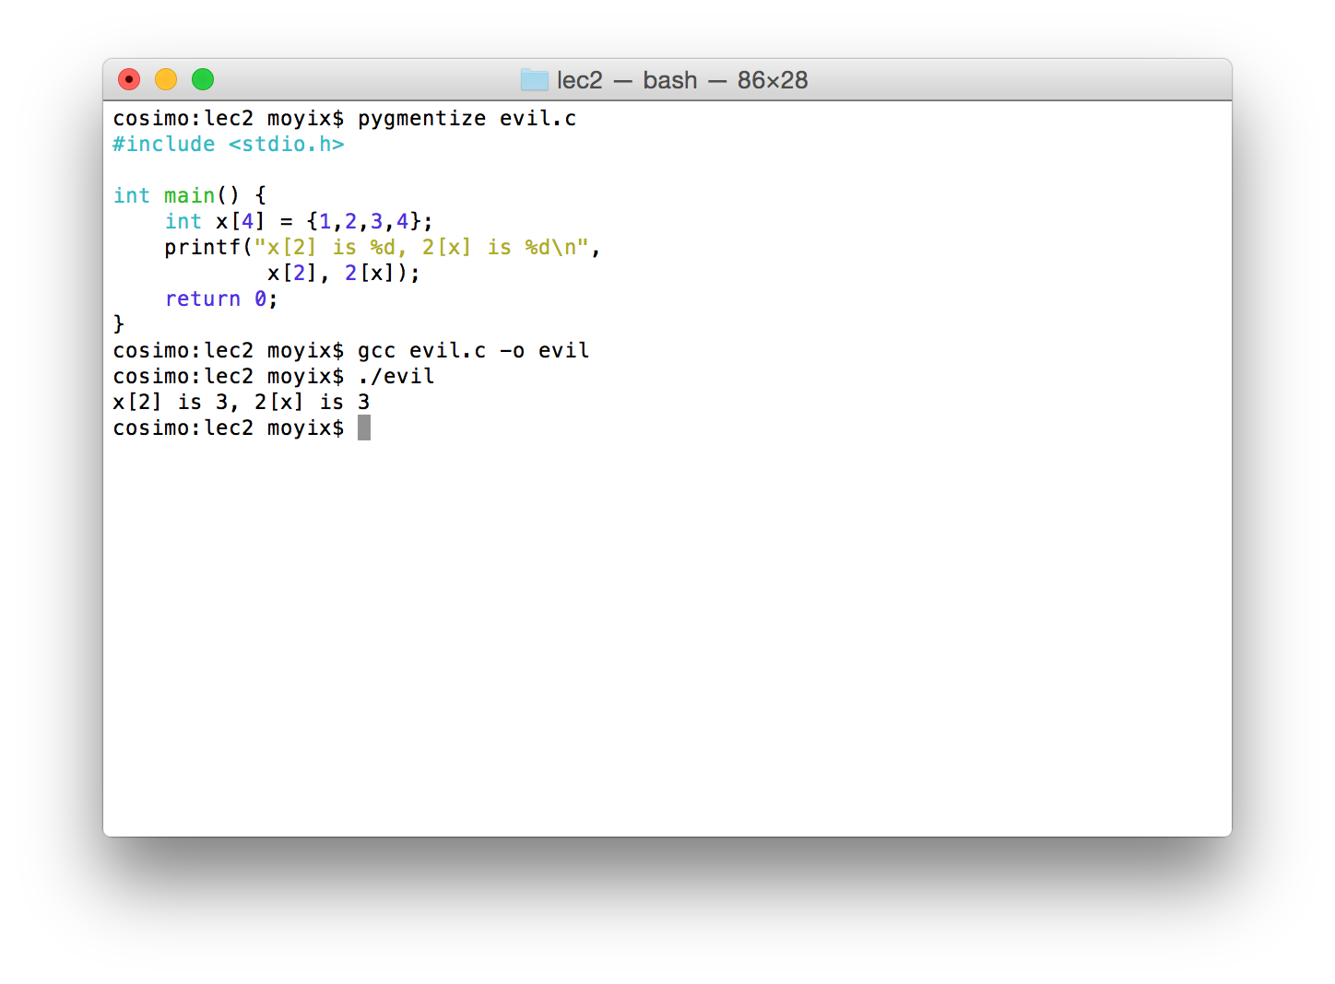

Slide 74
DO NOT EVER DO THIS IN REAL CODE

Slide 75
Memory Allocation
Recall that I said C only supports fixed-length arrays
So how do you deal with variable amounts of data?
To allocate: p = malloc(size in bytes) – returns a pointer to a memory region that you can then assign to a variable of whatever type you like
To free: free(p)

Slide 76
Memory Allocation
Once again, C is not going to hold your hand:
You have to know how much space you need
You are responsible for freeing memory you allocate
You are responsible for making sure you don't try to put too much data into too small a buffer

Slide 77
Example: Linked List
struct list {
int data;
struct list *next;
};

Slide 78
Insertion
struct list * list_insert(struct list *head, int data) {
struct list *new = malloc(sizeof(struct list));
new->data = data;
new->next = head;
return new;
}

Slide 79
Insertion
struct list * list_insert(struct list *head, int data) {
struct list *new = malloc(sizeof(struct list));
new->data = data;
new->next = head;
return new;
}
Memory allocation
sizeof operator gets the size of a type

Slide 80
Example: Linked List
int main() {
int i;
struct list *head = NULL;
struct list *cursor = NULL;
// Add some stuff to our list
for (i = 0; i < 20; i++) {
head = list_insert(head, i * 2);
}
// Now print it out
cursor = head;
while (cursor != NULL) {
printf("List entry at %p has data %d\n",
cursor, cursor->data);
cursor = cursor->next;
}
// And free everything
cursor = head;
while (cursor != NULL) {
struct list *to_delete = cursor;
cursor = cursor->next;
free(to_delete);
}
}

Slide 81
Example: Linked List
int main() {
int i;
struct list *head = NULL;
struct list *cursor = NULL;
// Add some stuff to our list
for (i = 0; i < 20; i++) {
head = list_insert(head, i * 2);
}
// Now print it out
cursor = head;
while (cursor != NULL) {
printf("List entry at %p has data %d\n",
cursor, cursor->data);
cursor = cursor->next;
}
// And free everything
cursor = head;
while (cursor != NULL) {
struct list *to_delete = cursor;
cursor = cursor->next;
free(to_delete);
}
}
Freeing memory

Slide 82
Output
List entry at 0x7b6517d0 has data 38
List entry at 0x7b6517c0 has data 36
List entry at 0x7b6517b0 has data 34
List entry at 0x7b6517a0 has data 32
List entry at 0x7b651790 has data 30
List entry at 0x7b651780 has data 28
List entry at 0x7b651770 has data 26
List entry at 0x7b651760 has data 24
List entry at 0x7b651750 has data 22
List entry at 0x7b651740 has data 20
List entry at 0x7b651730 has data 18
List entry at 0x7b651720 has data 16
List entry at 0x7b651710 has data 14
List entry at 0x7b651700 has data 12
List entry at 0x7b6516f0 has data 10
List entry at 0x7b6516e0 has data 8
List entry at 0x7b6516d0 has data 6
List entry at 0x7b6516c0 has data 4
List entry at 0x7b6516b0 has data 2
List entry at 0x7b6516a0 has data 0

Slide 83
Example: Linked List
int main() {
int i;
struct list *head = NULL;
struct list *cursor = NULL;
// Add some stuff to our list
for (i = 0; i < 20; i++) {
head = list_insert(head, i * 2);
}
// Now print it out
cursor = head;
while (cursor != NULL) {
printf("List entry at %p has data %d\n",
cursor, cursor->data);
cursor = cursor->next;
}
// And free everything
cursor = head;
while (cursor != NULL) {
struct list *to_delete = cursor;
cursor = cursor->next;
free(to_delete);
}
}
Why did we have to use the extra to_delete variable?

Slide 84
Things Not Covered
Function pointers
Code in multiple files
Linking to external libraries
Preprocessor macros
Some modifiers: static, const, volatile, extern
Ternary operator, variable-argument functions (e.g., printf)

Slide 85
For Next Time
Some fun reading to set the mood: The Night Watch, by James Mickens (available on NYU Classes)
Get started reading Modern Operating Systems and the xv6 book (specific chapters listed on the syllabus)
MOS 1.5.6 and xv6 chapter 0 will be particularly helpful for the first assignment
Install the tools, either locally or using the class VM.

